Slide 1



Disaster Management System: Database Design and Implementation
In the face of increasing disaster events, both natural and man-made, our team was tasked with the development of a robust disaster management system aimed at mitigating the impact of disasters through enhanced data coordination and response efficiency. This report outlines the database design and implementation phase, which is foundational to the system’s operational success.
by Group 20

Slide 2

Conceptual Design 1/2
During the conceptual design phase, we developed an Entity-Relationship (ER) Diagram to visualize the data relationships crucial to disaster management. This diagram helped us understand the key entities involved and how they interact with each other.
Entities Identified
Key Relationships and Cardinalities
We identified several key entities, including Users, Authorities, Respondents, Emergencies, Contacts, and Alerts, Calls, and Reports. Each entity represents a distinct type of data within the system.
We defined the relationships between these entities, such as Authorities issuing directives to Respondents, Users sending and receiving Alerts, and Respondents generating Reports. We also established the cardinality of these relationships, indicating the number of instances of one entity that can be associated with another.

Slide 3
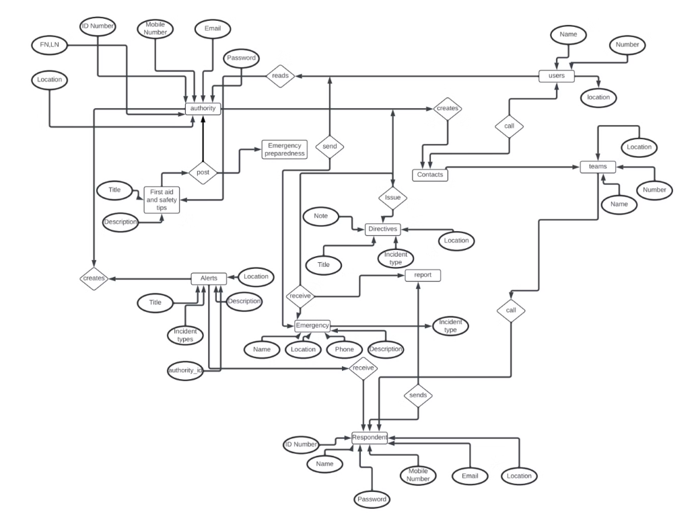
Conceptual Design 2/2

Slide 4

Logical Design 1/2
In this phase, we translated our conceptual ER diagram into a logical model, normalizing data to reduce redundancy and improve integrity. This involved creating tables, defining attributes, and establishing primary and foreign keys.
1
Schema Definition
We created tables like Users, Authorities, Emergencies, each reflecting the system’s entities. We defined attributes such as ID Number, Name, Location, and Email, using data types appropriate for the content (e.g., VARCHAR for text, INT for numerical data). We also established Primary Keys and Foreign Keys to maintain referential integrity across the relational database.

Slide 5
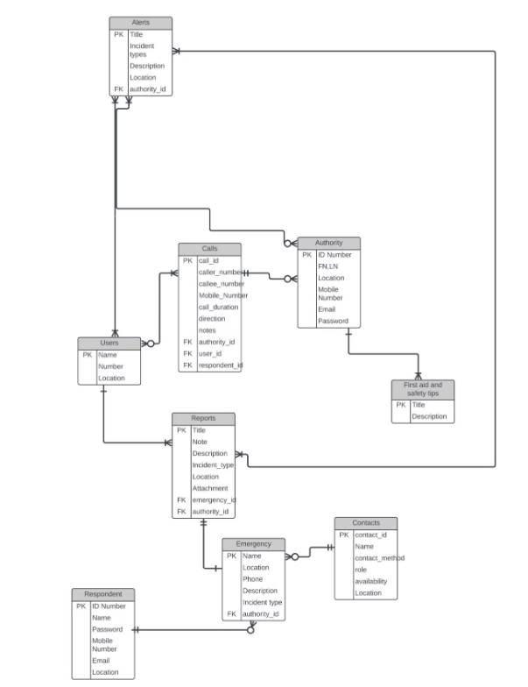
Logical Design 2/2

Slide 6
Physical Design
We selected MYSQL workbench as our Database Management System (DBMS) due to its robustness, scalability, and support for complex queries necessary for disaster management. This choice ensured that our database could handle the demands of a real-world disaster management system.
Physical Storage Considerations
Database Security Design
We implemented indexing on frequently accessed fields like User ID and Emergency Type to speed up queries. We also employed partitioning on historical data to improve performance and manageability.
We implemented data encryption both at rest and in transit using mySQL workbench native support. We also setup role-based access controls to ensure that data is only accessible to authorized personnel, crucial for protecting sensitive information.

Slide 7
SQL Database Implementation 1/3
Our SQL implementation phase involved the actual creation of the database schema based on our design. This involved executing SQL scripts to create tables, define relationships, and set constraints.
SQL Scripts
Results
Executed SQL scripts to create tables, define relationships, and set constraints.
Successfully created tables, defined relationships, and set constraints.
Example SQL for creating the Users table:
The Users table was successfully created.
Scripts can be found here: https://github.com/duesenberry55/CEF440-group-20/tree/main/task%206
The scripts are available for review.

Slide 8
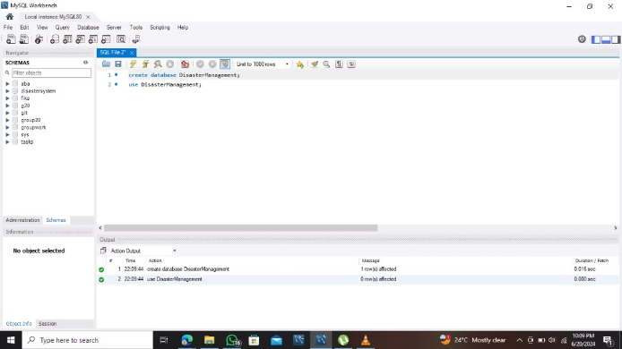
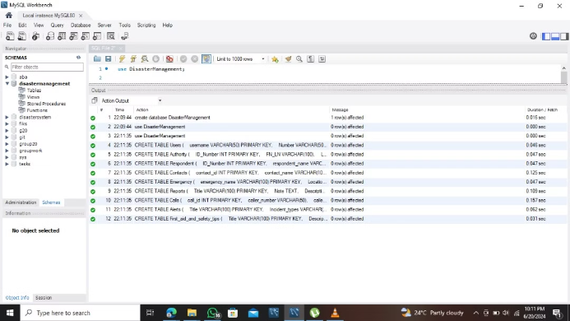
SQL Database Implementation 2/3

Slide 9
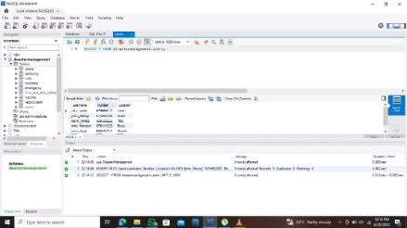
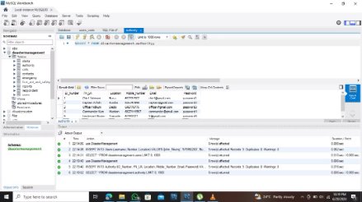
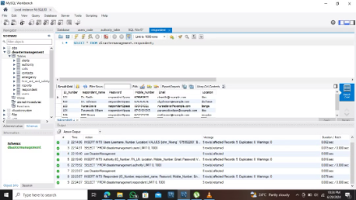
SQL Database Implementation 2/3

Slide 10




Technologies Used
We utilized a variety of technologies to support our database design and implementation process. These technologies provided us with the tools and capabilities necessary to create a robust and secure database.
Database Management System (DBMS):
Development Environment:
Data Modeling Tools:
Security Technologies:
We utilized mySQL workbench, providing us with a graphical interface to facilitate database design and manipulation.
Lucid chart was used to create detailed ER diagrams, supporting our data modeling and schema design processes.
We implemented AES encryption standards through PostgreSQL for data at rest and TLS for data in transit.
mySQl was chosen for its advanced features, reliability, and open-source nature.

Slide 11




Testing and Validation
Extensive testing was conducted to ensure the integrity and performance of the database. These tests helped us identify and address any potential issues before deploying the system.
Unit Testing
Performed unit testing on individual tables to ensure that each table functioned correctly and met our requirements.
Integration Testing
Conducted integration testing to ensure that table relationships were properly enforced and that data could be transferred between tables without errors.
Load Testing
Implemented load testing to simulate real-world usage scenarios and measure the system’s performance under various load conditions.

Slide 12

Importance of Database Management in the Disaster Management System
The structured organization of our database has significantly improved data retrieval times and accuracy, which is critical during ongoing disaster events. The system supports dynamic reporting and analysis, enabling decision-makers to quickly understand disaster impacts and coordinate appropriate responses. Additionally, the database is designed to scale, accommodating an increasing volume of disaster data and evolving management requirements.

Slide 13
Conclusion
The database design and implementation phase has successfully laid down the backbone for the disaster management system. Our choices in technology and design principles have created a scalable, secure, and robust database that meets the critical demands of disaster management.

Slide 14
Thank you

